Slide 1
Fair, Democratic and Sustainable Cities – History and Methodology of Rede Nossa São Paulo

Slide 2
THE NETWORK CONSTRUCTION ⬅
Rede Nossa São Paulo was born from a deception with the debates and proposals submitted in 2006 elections;
from the need to build a country based on the sustainable development
guidelines.

Slide 3
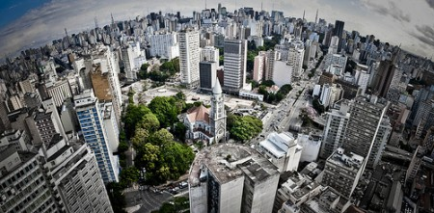
THE NETWORK CONSTRUCTION ⬅
from a group of persos united to work for the common welfare, showing that life conditions can improve, even in the greatest metropolis of South America: Nossa São Paulo.

Slide 4
THE NETWORK CONSTRUCTION ⬅
Objective: Rede Nossa São Paulo was built so that a social and political force could be created and enable improvements in the cities.

Slide 5
THE NETWORK CONSTRUCTION ⬅
Rede Nossa São Paulo was born to:
promote social justice;
follow up and help governments to work;
improve the political system and the services performed to society;
contribute to improve life quality in the Brazilian cities where about 85% of the population lives.

Slide 6
THE NETWORK CONSTRUCTION ⬅
Show that it is possible to build fairer cities, socially, environmentally, economically, culturally and politically sustainable.
Promote the sustainable development of the country.

Slide 7
THE NETWORK CONSTRUCTION ⬅
Hundreds of persons and dozens of organizations involved and engaged in the construction of Rede Nossa São Paulo;

Slide 8
THE NETWORK CONSTRUCTION ⬅
Intended to be an action reference of civil society in the search for equality, respect, fulfillment of targets and life improvement in the Brazilian cities.

Slide 9
THE NETWORK CONSTRUCTION ⬅
Rede Nossa São Paulo was launched in May 2007, and already counted on the support from 200 organizations;
Currently, there are 700 organizations.

Slide 10
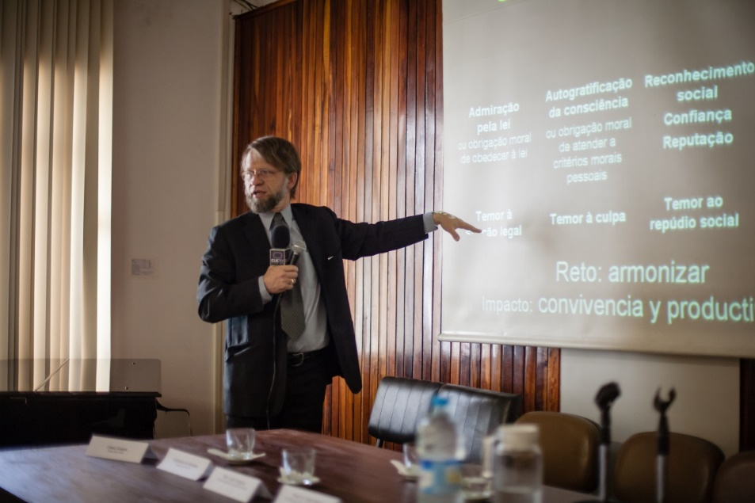
FIRST STEPS⬅
A group of leaderships visits Bogotá, which underwent a period of significant changes – administrative and social and cultural.

Slide 11
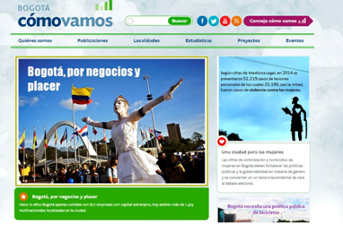
FIRST STEPS ⬅
This group knew the movement Bogotá como vamos? [Bogota, how are we?”], which takes care of monitoring the city’s life quality through indicators, technique and perception polls.

Slide 12
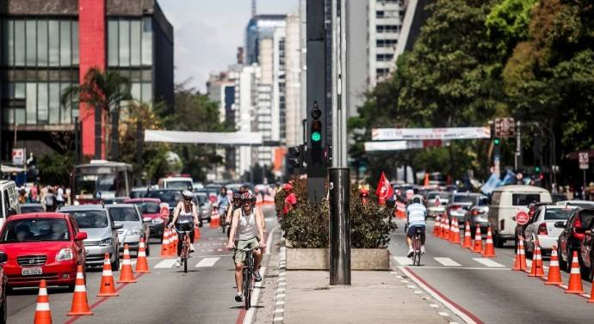
WHY SÃO PAULO?⬅
For its dimension and complexity,
For the concentration of problems that may be found in the whole country.
For its capacity to generate exemplarity.

Slide 13
PROPOSALS ⬅
Unite efforts regarding the problems of São Paulo
Increase the capacity of civil society
Call the attention of politicians to responsibility
Influence the decision-making of the public administration
Improve the government programs
Increase the performance of civil society in the mechanisms of transparence, participation, political incidence and control over the public powers.
(...)

Slide 14
FOUNDING GUIDELINES ⬅
Learn with successful experiences;
Innovate and dare in the proposals and in the form of activities.

Slide 15
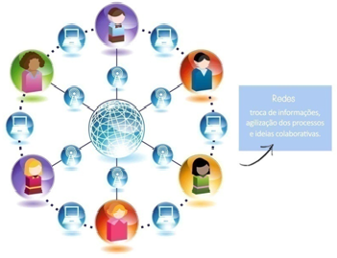
FOUNDING GUIDELINES ⬅
Gather technical capacity to innovate with quality;
Produce knowledge and information;
Use the new information tecnologies in favor of the cause.
(...)

Slide 16
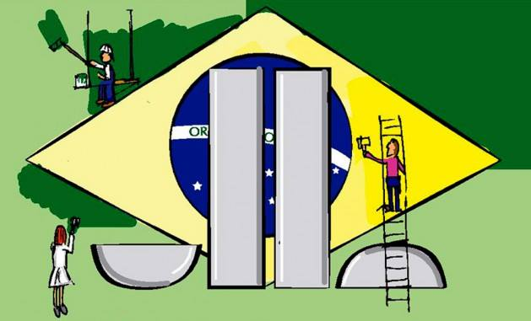
FOUNDING GUIDELINES ⬅
Promote citizenship education;
Promote social mobilization;
Follow up and influence the public administrators and policies.

Slide 17
MAIN CONCEPT⬅
Make use of the knowledge and the power of action and mobilization from several actors.
Strenghten the actors that are part of the network so as not to create a growing institutional structure;
Horizontal strengthening in several areas:
Plural civil society, well organized, strengthened , working and communicating in network.

Slide 18
ADMINISTRATIVE STRUCTURE⬅
Legal entity of the Executive Secretariat:
Instituto São Paulo Sustentável
Executive Secretariat
Supporting
Collegiate Body
Work Groups (WGs)
Inter Group Work

Slide 19
ADMINISTRATIVE STRUCTURE ⬅
Executive Secretariat: network animator. Takes care of the operationalization, communication, technical production, mobilization, themes required by the supporting collegiate body and by the Work Groups (WGs).
Supporting Collegiate Body: convenes monthly to deal with more strategic themes. Responsible for the general coordination. Composed of persons and organizations that participated in the first steps of the network: conception, organization and foundation.

Slide 20
ADMINISTRATIVE STRUCTURE ⬅
Work Groups (WGs): deal with specific themes. Have broad autonomy and freedom regarding staff and agenda. Join efforts and accelerate conquests. Contribute to make progresses in the proposals and to improve the social control.
Inter Group Work: Enables a greater level of interaction among the participants of the Network. Several times, participates in meetings of the Supporting Collegiate Body to provide it with specific information.

Slide 21
The activities of Rede Nossa São Paulo
are based on 4 great foundations:
Indicators and targets program ;
Citizen following up;
Citizenship culture;
Citizenship mobilization.

Slide 22
Rede Nossa São Paulo is a total APARTISAN initiative and does not accept resources from public sources.

Slide 23
The financing is made through Brazilian and international private companies and foundations.
A part of the resources also derives from voluntary work and organizations’ pro bono work.

Slide 24
Get to know some of our
actions:

Slide 25
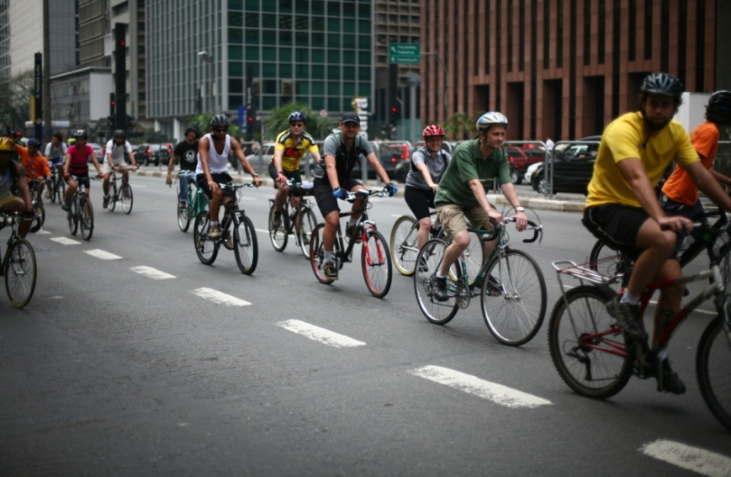
World free-day car ⬅
The Network has participated since 2007 in World Free-Day Car
The mobilization calls the attention to traffic problems and challenges in the great cities;
Contributes to proposals
and alternatives for the
urban mobility;

Slide 26
World free-day car ⬅
For a better public transportation;
Less transit, pollution, respect the pedestrians and cyclists and better life quality;
The initiative cooperates with the discussion about the mobility concept serving as entrance door for themes as inequality, urban planning, health, environment, among others.

Slide 27
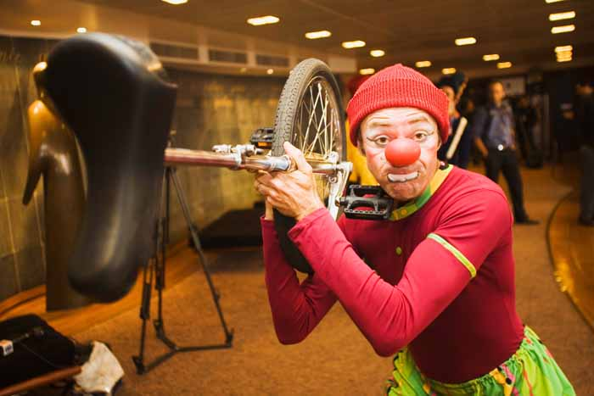
World free-day car ⬅
Encouraged the involvement of the civil society
in the city’s problems.
Served to present Rede Nossa São Paulo to the society.

Slide 28
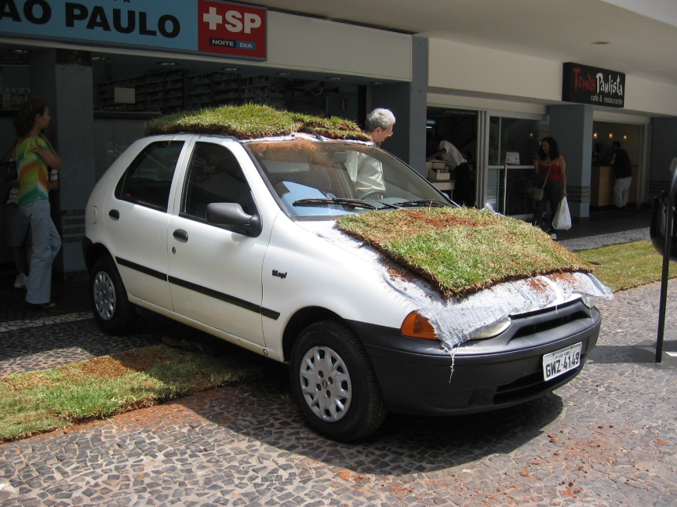
“VAGA VIVA” –
The Living Car Space ⬅
Occupations of car parking places on streets;
Seek humanization of the public space;

Slide 29
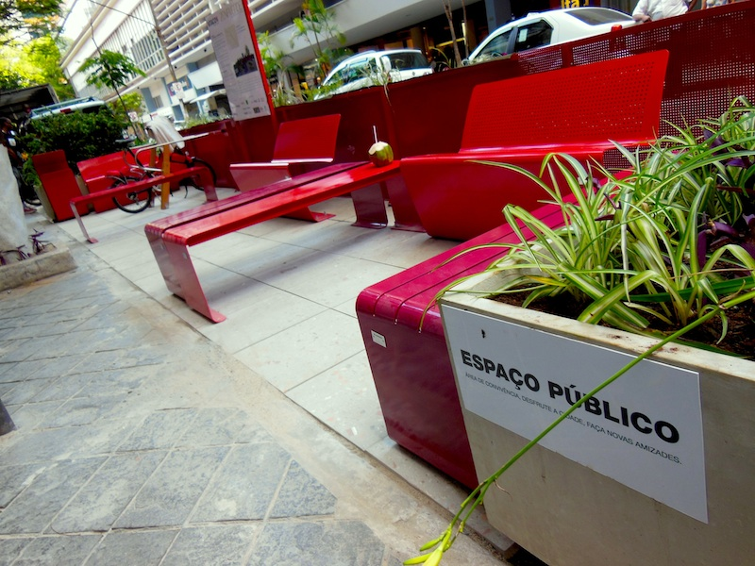
The Living Car Space ⬅
The initiative of Vaga Viva generated the current legislation on parklets in São Paulo – a temporary urban intervention, which discusses the public space and the use of soil democratically:

Slide 30
IBOPE’s RESEARCH⬅
Every year, on the World Free-Day Car, the Ibope’s research is launched on the mobility conditions in the city of São Paulo.

Slide 31
IBOPE’s RESEARCH⬅
The research shows the indicators about how the population lives and feels the mobility issue: daily time in the traffic, opinion on the Bycicle Lanes, the transport used to go working, etc.
The research also serves as a manner of government following up, based on which it is possible to notice if the traffic status is improving or not.

Slide 32
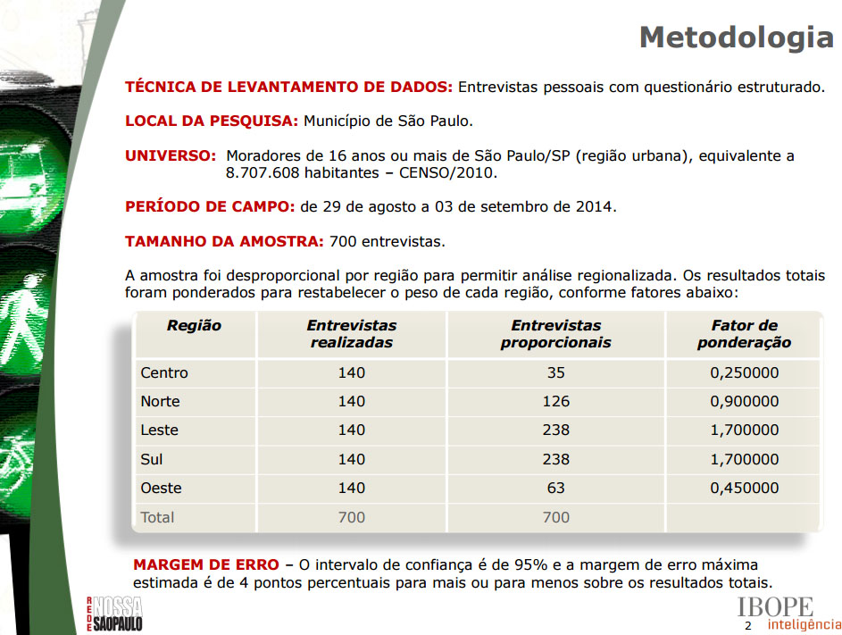
IBOPE’s RESEARCH⬅

Slide 33
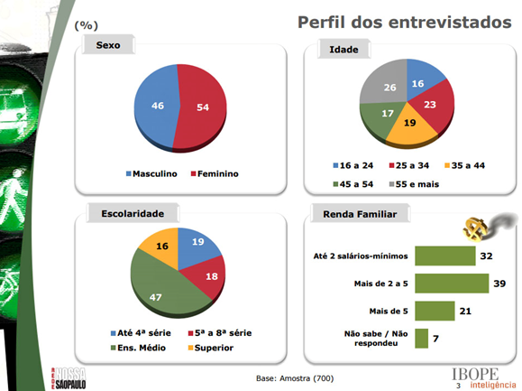
IBOPE’s RESEARCH⬅

Slide 34
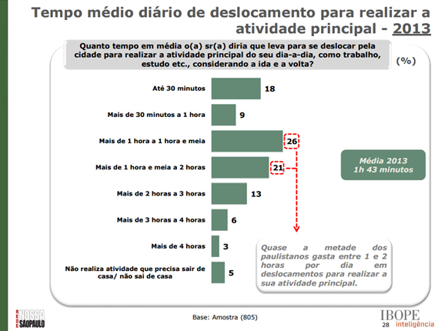
IBOPE’s RESEARCH ⬅

Slide 35
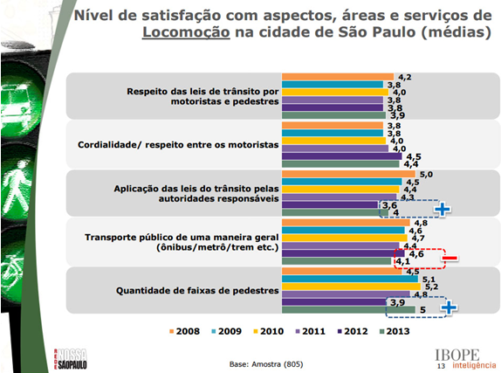
IBOPE’s RESEARCH ⬅

Slide 36
MOBILITY PLAN ⬅
In 2010, Rede Nossa São Paulo promoted together with the City Council of São Paulo, several seminars on the theme “Sustainable Mobility and Transportation”.
Objective: construct an agenda involving civil society and public power in approaching the mobility challenges of São Paulo.
Method: based on the evaluation of the technical indicators, the relation between transport and health and the proposals connected with the local and state budgets.

Slide 37
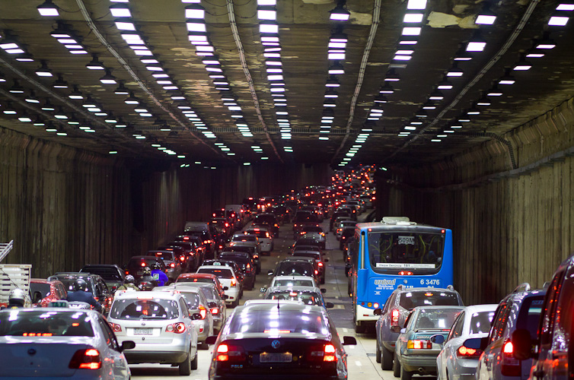
MOBILITY PLAN ⬅
Proposal: encouraging the creation of a Municipal Plan of Sustainable Mobility and Transportation in the city of São Paulo.

Slide 38
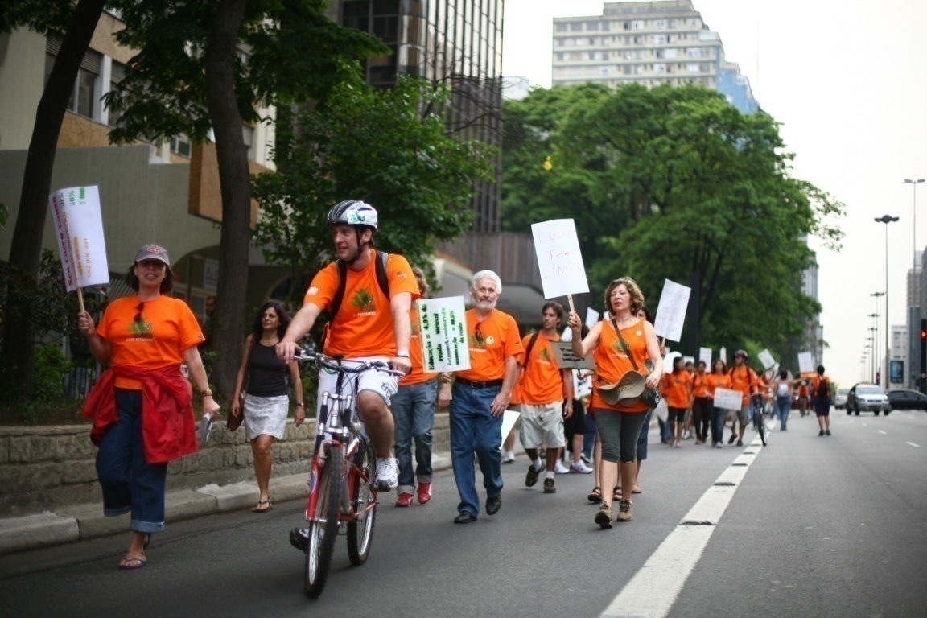
MOBILITY PLAN ⬅
Priorizing the pedestrian, the public transportation and the construction of bicycle lanes.

Slide 39
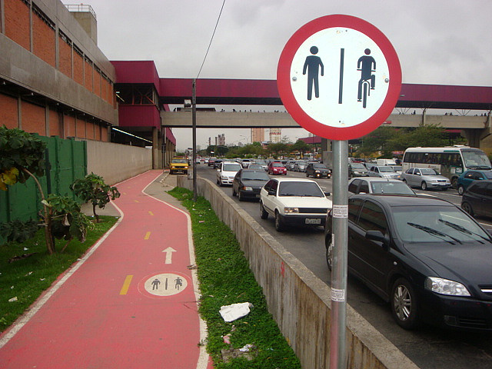
MOBILITY PLAN ⬅
The Sustainable Mobility Plan, developed by Rede Nossa São Paulo, inspired the changes that are being promoted in São Paulo.

Slide 40
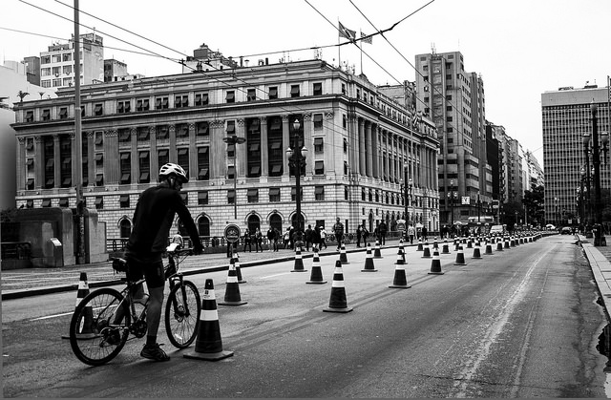
MOBILITY PLAN ⬅
The City Hall started to prioritize the public transportation and the construction of bicycle paths and bicycle lanes.

Slide 41
THE DIESEL BATTLE -
Cleaner Diesel Oil ⬅
Rede Nossa São Paulo adhered to the fight for resolution 315, of 2002: a resolution of National Environmental Council (CONAMA) that determines the obligation to sell at the gas stations:
Diesel 10 times cleaner and less
pollutant

Slide 42
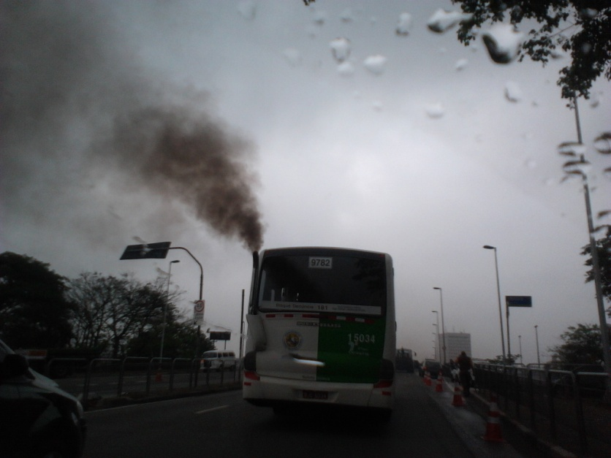
THE DIESEL BATTLE -
Cleaner Diesel Oil ⬅
The sulphur, a highly carcinogenic substance, is responsible for the death of three thousand people per year only in the Capital City of the State of São Paulo.
Conama’s resolution claimed a significant reduction of this substance, which was ignored for five years by the main persons in charge.

Slide 43
THE DIESEL BATTLE -
Cleaner Diesel Oil ⬅
This resolution only started to be be fulfilled by Petrobras and the automotive industry after an intense mobilization led by Rede Nossa São Paulo

Slide 44
IRBEM
[Reference Indicators for
Municipality Welfare] ⬅
Research monitoring 169 indicators, in 25 areas related to life quality in São Paulo.

Slide 45
IRBEM⬅
As it was built:
Work groups selected several items in 25 areas related to quality life.
The population was asked in a public consultation what are the most important ones in each area.
Thus, 169 indicators were selected.

Slide 46
IRBEM⬅
Every year Ibope analyzes the population’s satisfaction level with the items chosen in the public consultation as the most important ones for its welfare.

Slide 47
IRBEM⬅
IRBEM’s research furnishes real data and indicators on the city of São Paulo;
Thus, based on such data and indicators, the population may make requirements from its administrators;
And, the companies and organizations from the civil society may suggest and propel changes.

Slide 48
IRBEM⬅
IRBEM’s research furnishes a deep diagnosis of São Paulo and contributes to know and understand the issues that the population considered important.

Slide 49
IRBEM⬅
IRBEM’s objective is to provide maximum transparence and disclosure of all possible data on the city.
The indicators enable to know whether life quality is improving or worsening and where should improve.

Slide 50
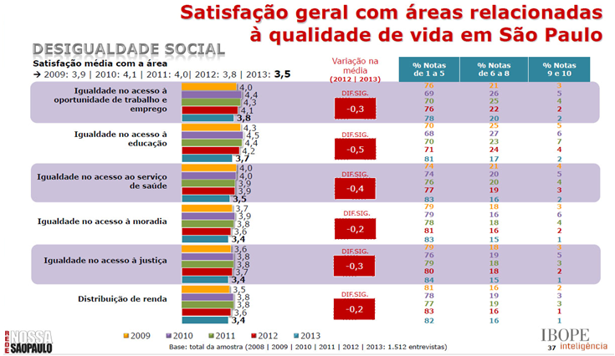
IRBEM⬅

Slide 51
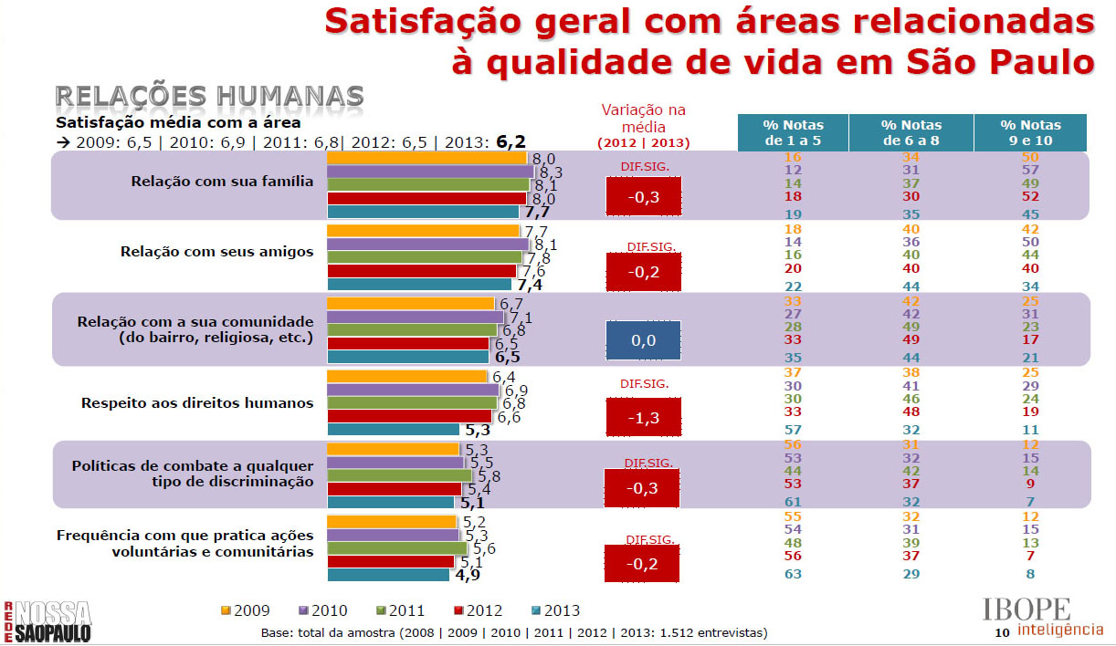
IRBEM⬅

Slide 52
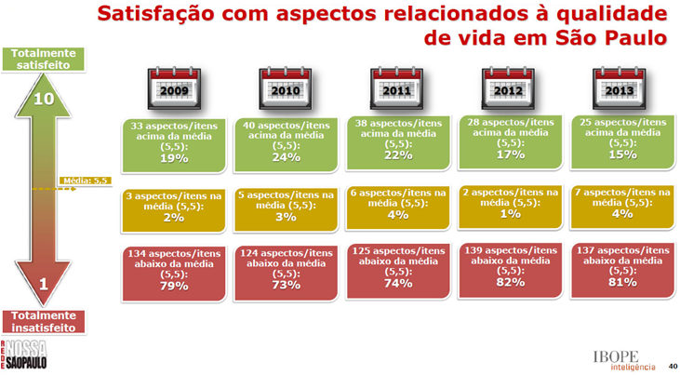
IRBEM⬅

Slide 53
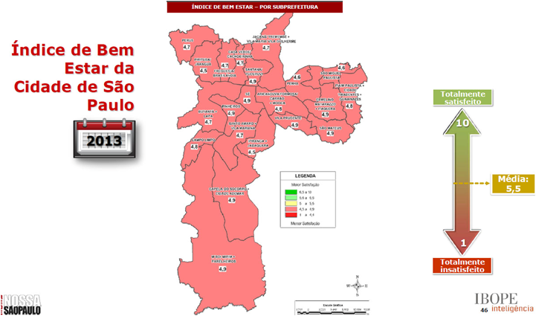
IRBEM⬅

Slide 54
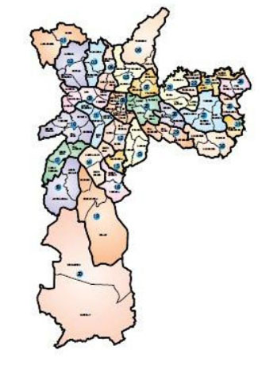
INEQUALITY MAP ⬅
The Inequality Map was another important tool developed by Rede Nossa São Paulo.
It indicates the inequality level between the richest and the poorest regions of the city

Slide 55
INEQUALITY MAP ⬅
It also indicates in which sub districts (32) and districts (96) the indicators are zeroed, that is, where there are no equipment and public services considered important for life quality.

Slide 56
INEQUALITY MAP ⬅

Slide 57
INEQUALITY MAP ⬅

Slide 58
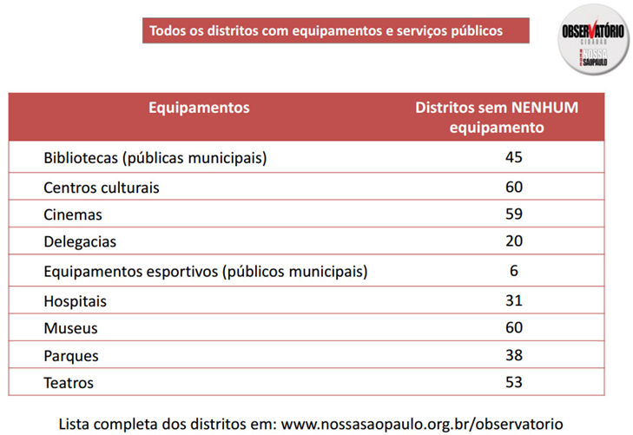
INEQUALITY MAP ⬅

Slide 59
LAW ON THE TARGET PROGRAM ⬅
Amendment to the Constitution of the City of São Paulo
A daring initiative that changed radically the form how the public administrators face the administration of the city of São Paulo.
And, inspired dozens of Brazilian and Latin American cities.

Slide 60
LAW ON THE TARGET PROGRAM ⬅
The objective was to ensure, by law, the mayors’ commitment to prepare and fulfil a target program and enable the society to follow up the administration and require the execution of the campaign promises.

Slide 61
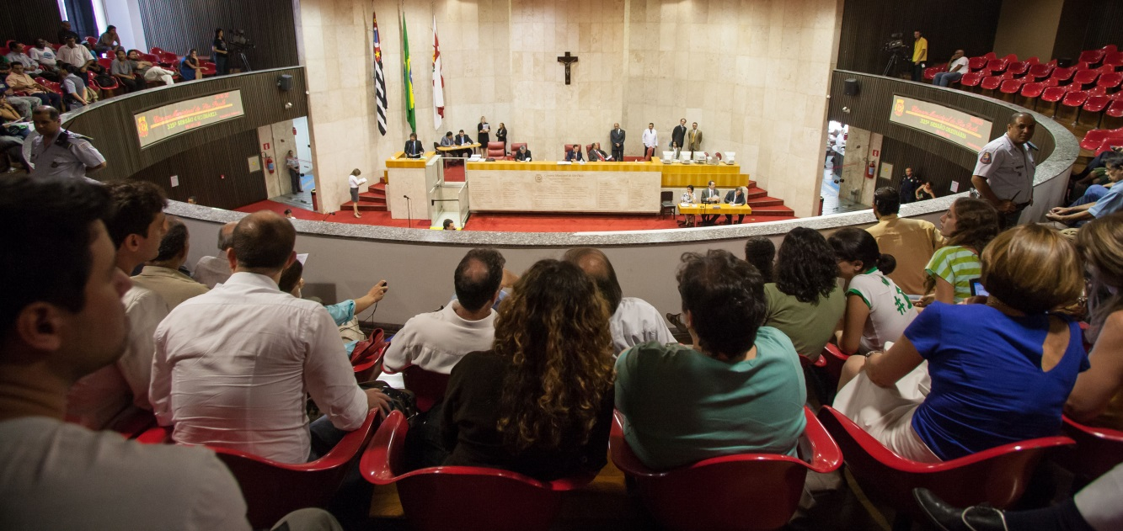
LAW ON THE TARGET PROGRAM ⬅
The Law on the Target Plan was submitted in 2007 and approved on February 18, 2008, in a historical session at the City Council.

Slide 62
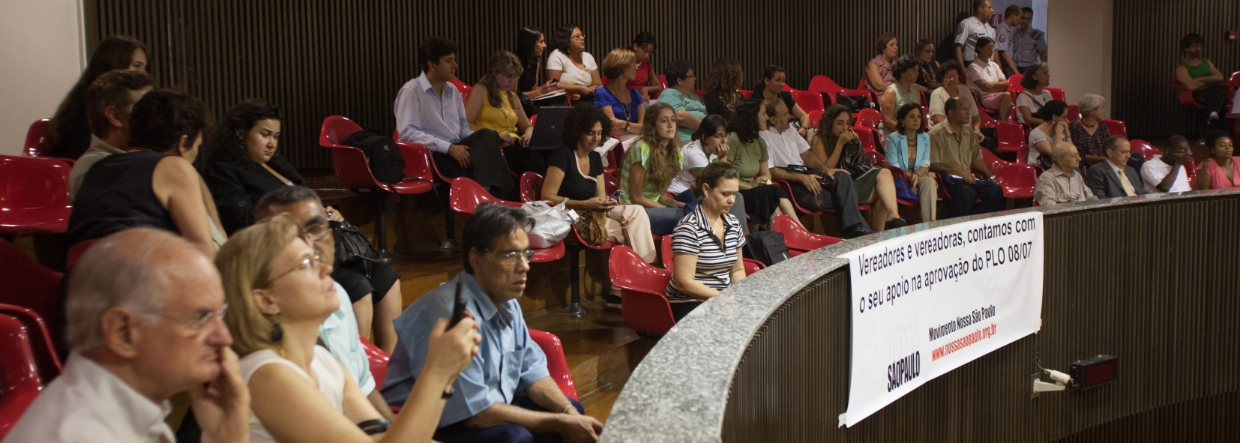
LAW ON THE TARGET PROGRAM ⬅
The approval counted on 54 councilors out of the 55 councilors in the City Council who voted in favor of the Target Law. The City Council was attended by a full plenary.

Slide 63
LAW ON THE TARGET PROGRAM ⬅
The Target Law is more than a law; actually, legislation existing in the City’s Organic Law.
It is a change in the organization of the city.
The development and the completion of the targets defined by the municipal administration may be followed up on the website Planeja Sampa (http://planejasampa.prefeitura.sp.gov.br/).

Slide 64
LAW ON THE TARGET PROGRAM ⬅
According to the Law on the Target Program, the mayor must:
Submit the targets for its administration within 90 days as of taking his office, under the penalty of becoming ineligible.
The targets shall be compatible with the guidelines of the electoral program.
The plan shall contain priorities, strategic actions and indicators.
The targets shall be subject to the sustainable evelopment guidelines. (...)

Slide 65
LAW ON THE TARGET PROGRAM ⬅
According to the Law on the Target Program, the mayor must:
Establish quantitative targets for each sector, sub districts and districts.
Discuss with the population at public hearings, including in sub districts.
Report the development of the targets on a semi-annual basis.

Slide 66
LAW ON THE TARGET PROGRAM ⬅
Improvements promoted by the Target Law:
City Planning
Public administration
Social control
Political culture
Transparence
Conscious vote
Objective evaluation of the City Hall
Fulfillment of the electoral program

Slide 67
LAW ON THE TARGET PROGRAM ⬅
More 39 Brazilian cities
and 5 Latin American cities
adopted the Target Program.

Slide 68
CITIZEN OBSERVATORY⬅
140 social, environmental, economic and political indicators on the city of São Paulo.

Slide 69
CITIZEN OBSERVATORY ⬅
Such indicators are constantly updated, evaluated and disclosed to the society.
The data are gathered in the municipal map and geo-referenced by the city’s districts and Sub districts.

Slide 70
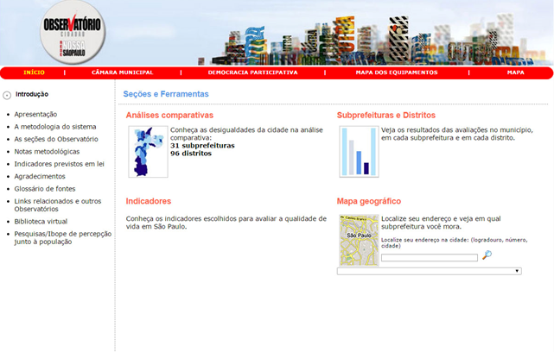
CITIZEN OBSERVATORY ⬅

Slide 71
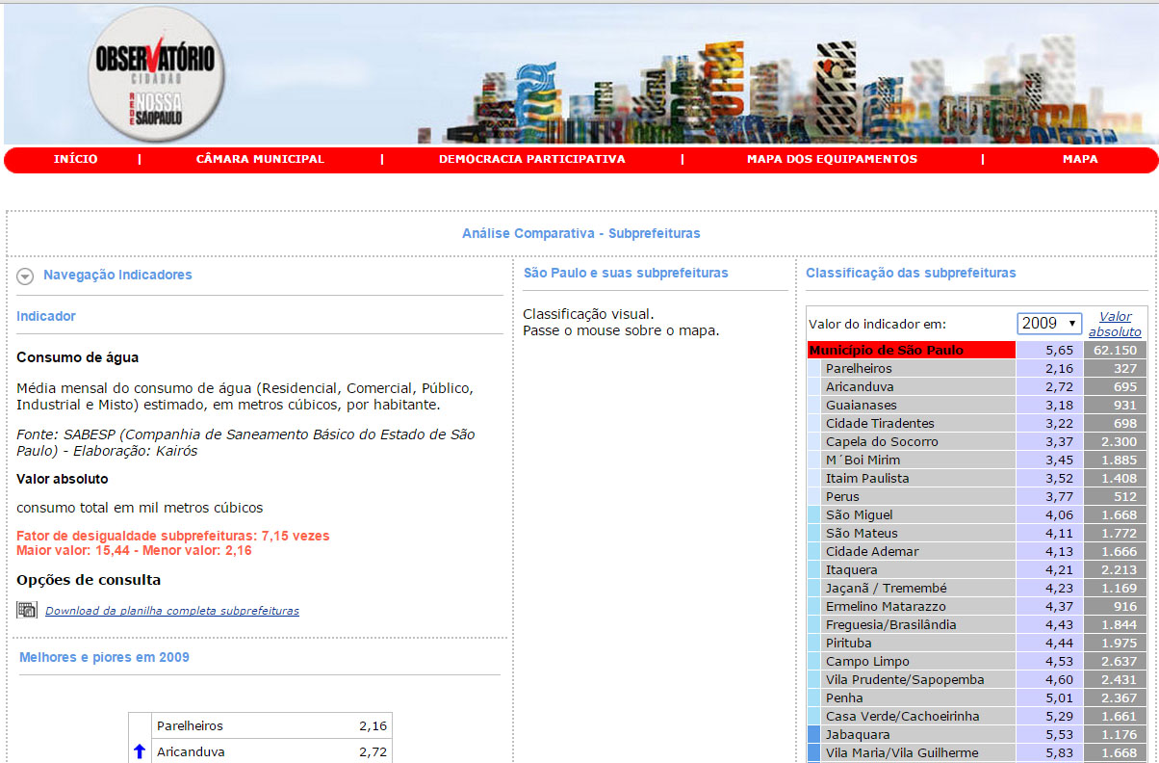
CITIZEN OBSERVATORY ⬅

Slide 72
MUNICIPAL COUNCILS⬅
Rede Nossa São Paulo encouraged the creation of municipal councils:
*in all 32 sub districts
Planning and Public Budget Council
Municipal Participative Council *
Council of the City of São Paulo
Traffic and Transport Municipal Council

Slide 73
MUNICIPAL COUNCILS⬅
Council of the City of São Paulo: advisory council connected with the city’s mayor and composed of approximately 100 leaderships of the city of São Paulo that assist the council.
Municipal Participative Council
(in each of the 32 sub districts): the councilors are elected by the population.
(...)

Slide 74
MUNICIPAL COUNCILS ⬅
Traffic and Transport Municipal Council (CMTT): discusses the mobility issues in the city of São Paulo
Planning and Public Budget Council (CPOP): follows up the budget and the target plan.

Slide 75
MUNICIPAL COUNCILS ⬅
The councils promoted:
propositional participation
integrated planning
monitoring
social control

Slide 76
MEETING WITH CANDIDATES⬅
Meetings are held with candidates for public offices to increase the society’s participation in the electoral process and its interest by politics in each election.
The proposal is make the candidates talk about their government programs, and if possible, about the targets to be developed if elected.

Slide 77
MEETING WITH CANDIDATES ⬅
It is an opportunity and a manner to record and commit the candidates to their promises in the electoral campaigns.

Slide 78
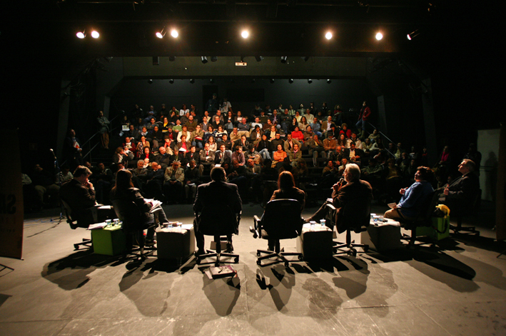
MEETING WITH CANDIDATES ⬅

Slide 79
MEETING WITH CANDIDATES ⬅
And, also to make them think of programs and undertake publicily the commitment to sustainable development.

Slide 80
MEETING WITH CANDIDATES ⬅
The Meeting with the Candidates has tried to solve one of the greatest frustrations with the Brazilian electoral process, and leveraged the creation of Rede Nossa São Paulo: the failure in following up the campaign promises in Brazil.

Slide 81
YOU AT THE PARLIAMENT⬅
The campaign “You at the Parliament” was an initiative held in partnership with the City Council to invite the society from the city of São Paulo to list the priorities in several areas, and then, guide the councilors’ work.

Slide 82
YOU AT THE PARLIAMENT ⬅
The citizen contributed to guide and prepare the wording of law bills, amendments to the city’s budget and other initiatives under City Council’s responsibility;

Slide 83
LEGISLATIVE –
SUSTAINABLE CITIES ⬅
Legislative – Sustainable Cities: is a project to evaluate the municipal legislative production under the view of the guidelines, indicators and references of good practices of municipal administrations of the Sustainable Cities Program
The bills of law are evaluated by non partisan civil society’s organizations that integrate the Work Groups of Rede Nossa São Paulo and the Brazilian Social Network for Fair, Democratic and Sustainable Cities

Slide 84
LEGISLATIVE-
SUSTAINABLE CITIES ⬅

Slide 85
LEGISLATIVE-
SUSTAINABLE CITIES ⬅

Slide 86
LEGISLATIVE-
SUSTAINABLE CITIES ⬅

Slide 87
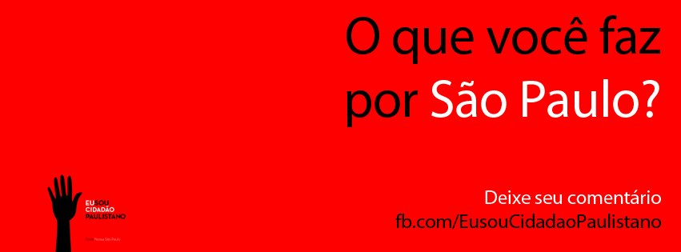
I AM A CITIZEN OF THE CITY
OF SÃOPAULO ⬅
Rede Nossa São Paulo also created the campaign “I am a Citizen of the City of São Paulo”
Objective: encourage the population of the City of São Paulo to appropriate the city, to exercise the citizenship and to be involved in actions of collective interest.

Slide 88
I AM A CITIZEN OF THE CITY
OF SÃOPAULO ⬅

Slide 89
I AM A CITIZEN OF THE CITY
OF SÃOPAULO ⬅

Slide 90
I AM A CITIZEN OF THE CITY
OF SÃOPAULO ⬅

Slide 91
KEEPING AN EYE ON THE TARGETS⬅
Built in partnership with Avina Foundation and MIT (Media Laboratory in Massachussets).
The following up allows the online contribution of the citizens, with suggestions, critics and questions about the implementation of the targets, via website or the applicative;
Organizations may include and divulge information on the municipal targets.

Slide 92
KEEPING AN EYE ON THE TARGETS ⬅
Helps participative councilors, citizens and civil society’s organizations to follow up and monitor the public authorities’ commitments such as the fulfillment of the Target Program, budget and allocation of resources.

Slide 93
KEEPING AN EYE ON THE TARGETS ⬅
Two technologies were developed. One of them is the website “Keeping an Eye on the Targets“:
http://deolhonasmetas.org.br/home

Slide 94
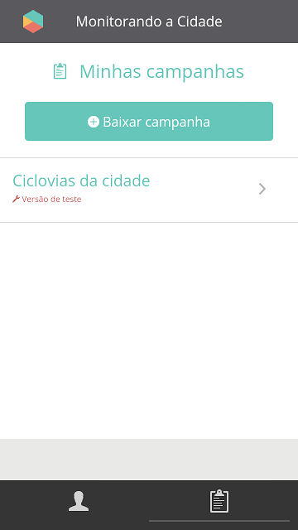
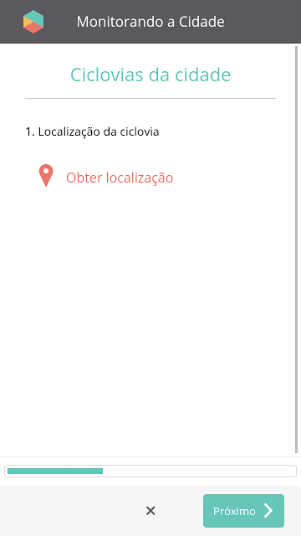
KEEPING AN EYE ON THE TARGETS ⬅
And, the other one is the applicative "Monitoring the city".

Slide 95
Get to know the methodology of
Rede Nossa São Paulo:

Slide 96
METHODOLOGY⬅
Some steps of the methodology adopted by Rede Nossa São Paulo were essential for the success of the initiative, to wit:
Choose São Paulo to generate exemplarity
Create a network to have political incidence
Have tools for following up public policies such as: Target Plan, Keeping an Eye on the Targets, Citizen Observatory, Inequality Map, IRBEM.
(...)

Slide 97
METHODOLOGY ⬅
Prepare proposals and pressure to have the proposals accepted
Citizenship culture: trust not only in the public policies, but also in the citizens’ behavior.
Follow up the work of the City Council.
(...)

Slide 98
METHODOLOGY ⬅
Important actions to generate a movement such as Rede Nossa São Paulo:
Articulate a non partisan movement of the civil society.
Create a movement in a horizontal network.
Structure the movement to favor the joint work.
(...)

Slide 99
METHODOLOGY ⬅
Maximize the fights and objectives to improve life quality in the city.
Wish a fair, democratic and sustainable city.
Create work agenda.
Create a public policy agenda.
(...)

Slide 100
METHODOLOGY ⬅
Generate exemplarity
Organize or participate in mobilization campaigns which aim is the city’s welfare.
Give transparence and disclose as much data as possible.
Build the Citizen Observatory.
(...)

Slide 101
METHODOLOGY ⬅
Create a News Portal and develop ties with journalists and means of communication.
Perform perception surveys with research institutes or universities.
Increase the political incidence of the society: better planning and management mechanisms in the administration.
Work for the implementation of the Target Program.
(...)

Slide 102
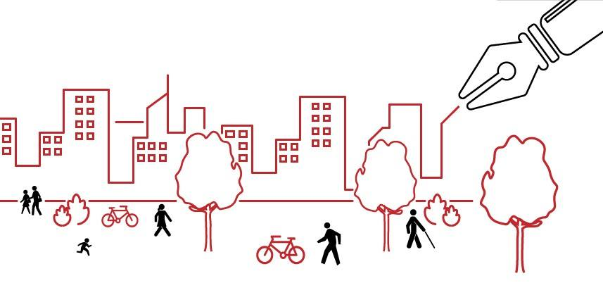
METHODOLOGY ⬅
Show conquests
Submit tools to other movements and cities.
Follow up the City Council’s routine.

Slide 103
SUSTAINABLE CITIES PROGRAM ⬅
The objective is to move and mobilize the Brazilian cities to build economically, socially and environmentally sustainable cities.

Slide 104
SUSTAINABLE CITIES PROGRAM ⬅
The Sustainable Cities Program was launched in 2011 by Rede Nossa São Paulo in a partnership with Brazilian Social Network for Fair, Democratic and Sustainable Cities and Instituto Ethos.

Slide 105
SUSTAINABLE CITIES PROGRAM ⬅
With focus on 2012 municipal elections, the program included the Sustainable Cities platform developed in the previous year and innovated by submitting tools for the commitment of the candidates and the following up by civil society.

Slide 106
SUSTAINABLE CITIES PROGRAM ⬅
Indicators: essential for the development, execution and evaluation of public policies aiming at planning more sustainable cities.
The Sustainable Cities Program had more than 300 indicators.

Slide 107
SUSTAINABLE CITIES PROGRAM ⬅
The objective is to commit the candidates and the elected mayors with a sustainable development platform. The platform is composed of 12 foundations; each foundation is split into several items, each item is related to an indicator and each indicator to an exemplary case or a reference.

Slide 108
PROGRAM FOUNDATIONS SUSTAINABLE CITIES
Governance
Common Natural Assets
Equity, Social Justice and
Culture of Peace

Slide 109
PROGRAM FOUNDATIONS SUSTAINABLE CITIES
Local administration for Sustainability
Urban planning and design
Culture for Sustainability

Slide 110
PROGRAM FOUNDATIONS SUSTAINABLE CITIES
Education for Sustainability and Life Quality
Local, Dynamic, Creative and Sustainable Economy
Responsible Consumption and Life Style Options

Slide 111
PROGRAM FOUNDATIONS SUSTAINABLE CITIES
Better Mobility, Less Traffic
From Local to Global
Local Action for Health

Slide 112
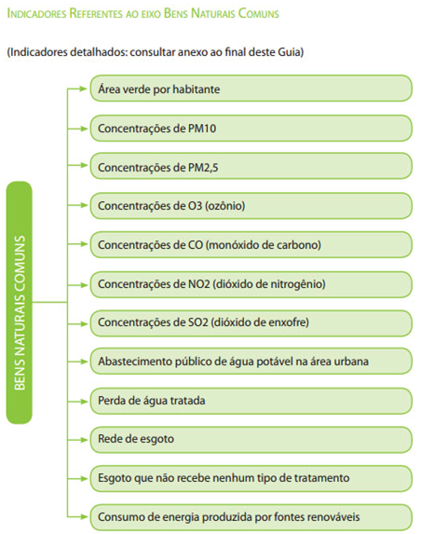
INDICATORS PER FOUNDATION OF THE
SUSTAINABLE CITIES PROGRAM

Slide 113
SUSTAINABLE CITIES PROGRAM ⬅
Targets: fixed so that the sustainable development is consolidated and the results may be evidenced.

Slide 114
SUSTAINABLE CITIES PROGRAM ⬅
Good practices: national and international references of excellence.
http://www.cidadessustentaveis.org.br/boas-praticas

Slide 115
SUSTAINABLE CITIES PROGRAM ⬅
Letter Commitment: directed to the candidates for the city halls to state the commitment of the possible administrators to the fair and sustainable development in the cities.

Slide 116
CAMPAIGN
I VOTE FOR SUSTAINABILITY ⬅
Campaign held in 2012
Developed by the civil society’s organizations
Invited electors to vote for candidates for mayors commited to sustainability
Directed also to candidates for the City Halls in the elections of that year, so that they adopted platforms with electoral programs

Slide 117
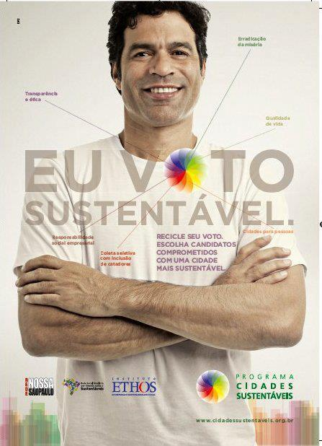
CAMPAIGN I VOTE FOR SUSTAINABILITY⬅
Counted on the participation of
public figures such as the athlete Raí
Oliveira and actors from Rede Globo:

Slide 118
SUSTAINABLE CITIES PROGRAM ⬅
Results:
Metropolises: 15 Cities (20% of the Brazilian population)
Large Cities: 9 Cities (3% of the Brazilian population)
Average Cities : 60 Cities (7% of the Brazilian population)
Small Cities: 191 Cities (3% of the Brazilian population)

Slide 119
SUSTAINABLE CITIES PROGRAM ⬅
Results:
21 Capital Cities’ signatories
Signatory Cities’ Population - 2014: 67.553.830
Brazilian Population - 2014: 202.768.562
Percentage of the Signatory Cities’ population: 33%

Slide 120
SUSTAINABLE CITIES PROGRAM ⬅
Qualification: Municipal governments have started to require from the Executive Secretariat of the Sustainable Cities Program that the established partnerships continue, mainly in the qualification of technicians and administrators of the City Halls.

Slide 121
SUSTAINABLE CITIES PROGRAM ⬅
O objective of such qualifications is to strengthen the knowledge on the program and the use of its methodology and software.

Slide 122
SUSTAINABLE CITIES
PROGRAM ⬅
In order to implement the
Qualifications, the Sustainable
Cities Program created the
“Guide for the Sustainable
Public Administration”, formed
by a publication and a set of
Didactic videos.

Slide 123
SUSTAINABLE CITIES PROGRAM ⬅
The program created a sustainable public administration and proposes the promotion, as of the city halls, of synergies among the scientific/technological, social/cultural and institutional sectors harmonizing the processes and impacts of the development in a local level, turning it into sustainable.

Slide 124
SUSTAINABLE CITIES PROGRAM ⬅
The objective is to always encourage the participation of the citizens as a manner to contribute to improve life quality of each region, making use of the exchange of information and experiences in local and global levels.

Slide 125
SUSTAINABLE CITIES PROGRAM ⬅
GPS is a guidance manual on how to implement the Sustainable Cities Platform, is composed of a fully detailed publication and several guidance videos.

Slide 126
SUSTAINABLE CITIES PROGRAM ⬅
Guide for the Sustainable Public Administration

Slide 127
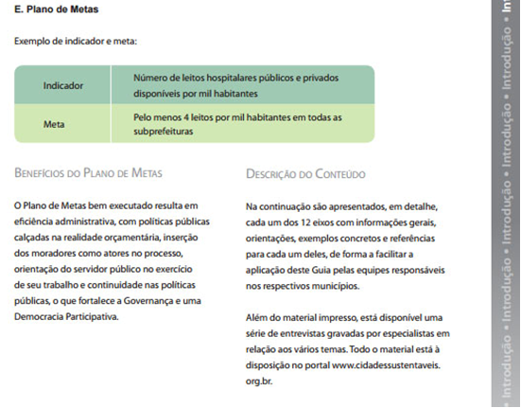
SUSTAINABLE CITIES PROGRAM ⬅
GPS

Slide 128
SUSTAINABLE CITIES PROGRAM ⬅
Access the “Guide for the Sustainable Public Administration” on:
http://www.cidadessustentaveis.org.br/sites/default/files/gps/arquivos/guiagps-cidadessustentaveis.pdf

Slide 129
SUSTAINABLE CITIES PROGRAM ⬅
TARGETS AND REFERENCES
The indicators are essential tools for the development, execution and evaluation of public policies aiming at planning more sustainable cities.

Slide 130
SUSTAINABLE CITIES PROGRAM ⬅
However, it is necessary to fix result goals so that the sustainable development is consolidated and the results may be evidenced as well as it is essential to promote the participation of the civil society in the decision-making process in the city.

Slide 131
SUSTAINABLE CITIES PROGRAM ⬅
For such purpose, it was prepared the publication Sustainability Targets for the Brazilian Cities: http://www.cidadessustentaveis.org.br/downloads/publicacoes/publicacao-metas-de-sustentabilidade-municipios-brasileiros.pdf

Slide 132
SUSTAINABLE CITIES PROGRAM ⬅

Slide 133
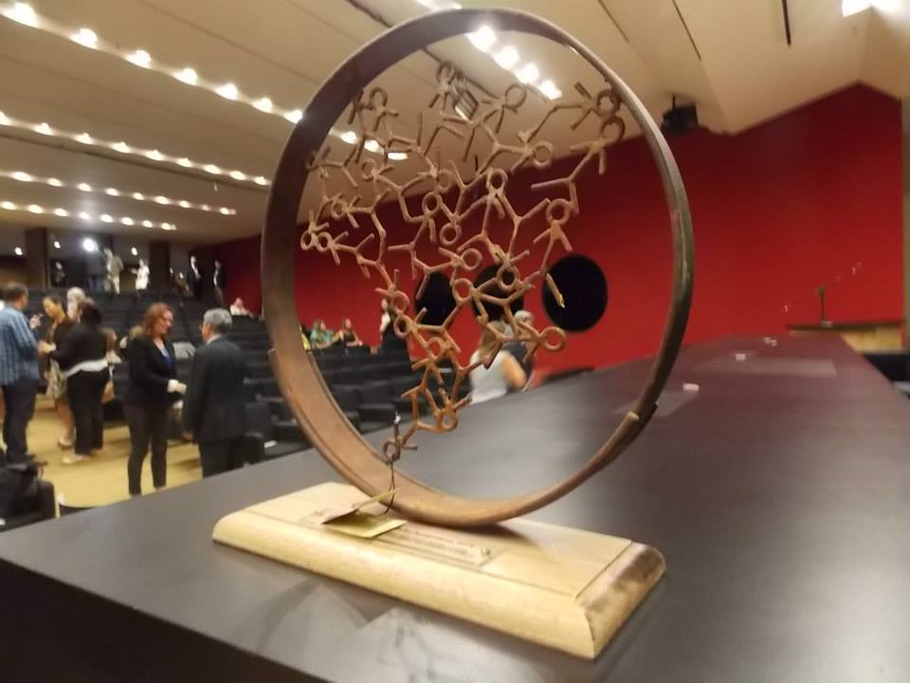
SUSTAINABLE CITIES AWARD⬅
The Award has a national scope and its first edition was held in 2014, with the participation of 57 cities of 15 Brazilian states.
In the first edition, the best Observatories were awarded once they are essential to ascertain the indicators and make the necessary changes in the city.

Slide 134
SUSTAINABLE CITIES AWARD ⬅
For such purpose, it was provided a publication guinding the installation of Observatories that may be acessed on:
http://www.cidadessustentaveis.org.br/downloads/arquivos/guia-uso-sistema-indicadores.pdf

Slide 135
SUSTAINABLE CITIES AWARD ⬅
The public restricted to the City Hall’s signatories of the Sustainable Cities Program;
In the next editions, the companies outstanding for the 12 thematic foundations of the program will be awarded.

Slide 136
INTERNATIONAL CONFERENCE ⬅
The Sustainable Cities Program held in April 2015 an international conference on the subject “Innovative Public Policies”

Slide 137
INTERNATIONAL CONFERENCE ⬅
Objective: to point out successful experiences of public policies in Brazilian cities and in the world.

Slide 138
INTERNATIONAL CONFERENCE ⬅
Mayors from several cities were invited to submit concrete experiences of excellence in administration.

Slide 139
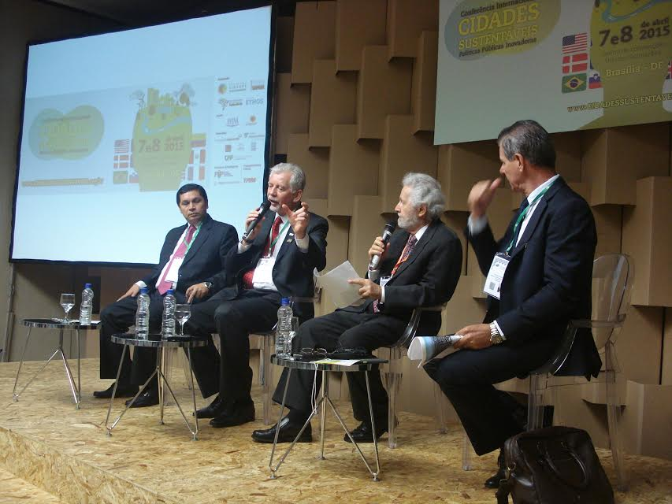
INTERNATIONAL CONFERENCE ⬅

Slide 140
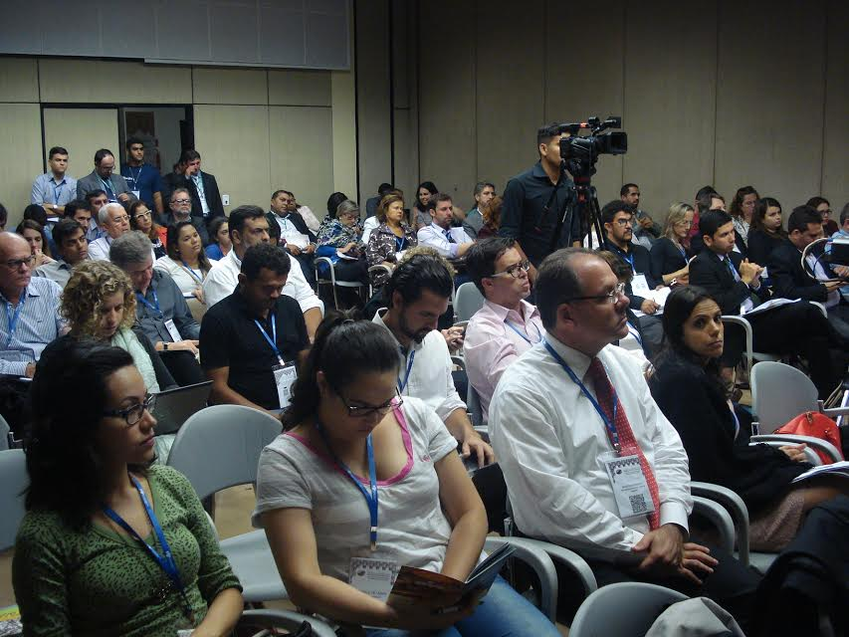
INTERNATIONAL CONFERENCE ⬅

Slide 141
BRAZILIAN SOCIAL NETWORK⬅
The Brazilian Social Network for Fairer, Democratic and Sustainable Cities was founded on July 8, 2008 in Belo Horizonte.
The network is formed by non partisan and inter-religious organizations.
Objective: exchange of information and knowledge to support and strengthen each local experience.

Slide 142
BRAZILIAN SOCIAL NETWORK ⬅
They are part of movements and initiatives aiming at promoting life quality in the cities, involving the society and committing governments to fair and sustainable development.

Slide 143
LATIN AMERICAN NETWORK ⬅
Latin American Network for Fair, Democratic and Sustainable Cities was created in 2008.

Slide 144
PEC (Proposal of Amendment to
the Constitution) of the Targets⬅
Rede Nossa São Paulo
submitted the PEC of the Targets,
which claims that the Target Plan is
adopted by all the mayors, the
Governors and the president of the
Republic, on a mandatory basis,
provided for in the Constitution.

Slide 145
More information may be found on the websites of
Rede Nossa São Paulo: http://www.nossasaopaulo.org.br
and of Sustainable Cities Program:
http://www.cidadessustentaveis.org.br

Slide 146
On the website Rede Nossa São Paulo it is also possible to find documents, presentations and videos with the history of Rede Nossa São Paulo.
All the assets of Rede Nossa São Paulo, including a magnificent image bank of the actions and activities of the network, is being organized for the availability of the public.

Slide 147
MANY THANKS!

